Slide 1
Practicum DSA-5900
Faculty supervisor: William H Beasley
Credits :3
Chanukya Lakamsani

Slide 2

Project-1
Internship - ICCEW
Client - Consumer Affairs
Position: Software Developer
Topic: Building a Prototype

Slide 3
Consumer Affairs
ConsumerAffairs is an online reputation management website which helps consumers make life’s most important purchases. The company was founded in 1998 by Jim Hood, an investigative reporter whose goal was to report new developments in Washington to consumers who may be affected by them, like seat belt laws or data privacy concerns.
The business model consists of three parts: the customers, the brands, and ConsumerAffairs itself. Consumers come to the site through various mediums, like search engines, online advertisements, etc. On the site, consumers engage with information about particular brands, and based on how many times they click on a certain brand’s information, the brands pay the site a certain fee.

Slide 4

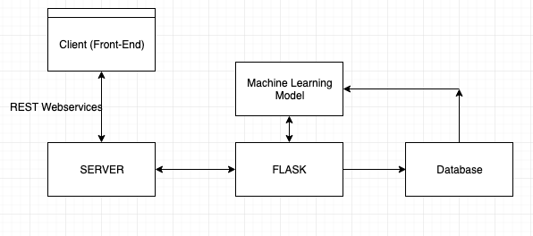
System Architecture

Slide 5
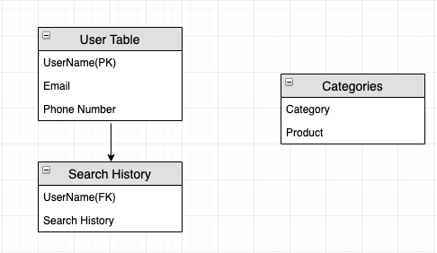
Database

Slide 6
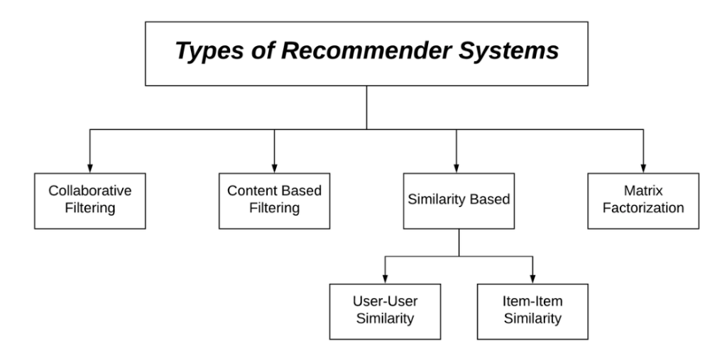
Recommendation systems

Slide 7
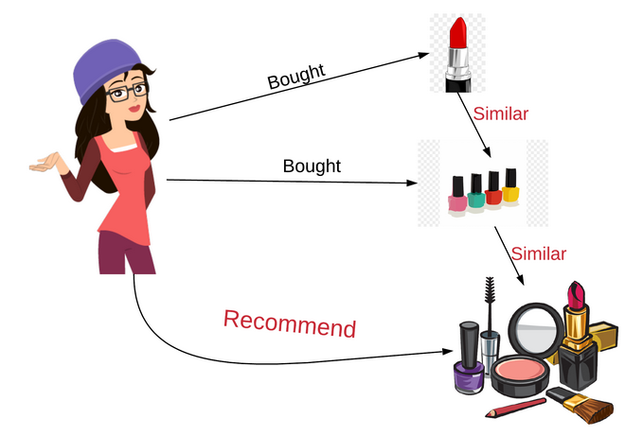
Simple Understanding of the Item- Item filtering Algorithm

Slide 8
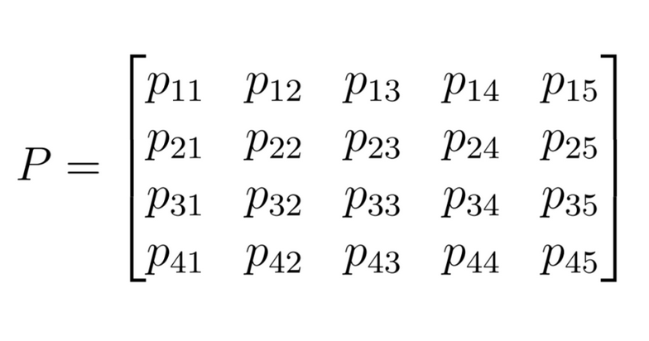
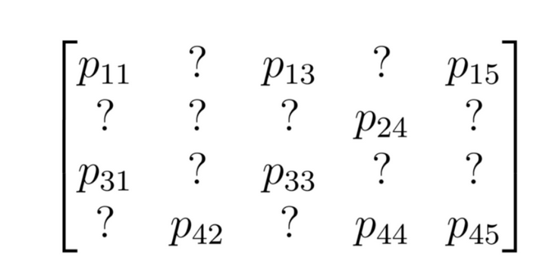
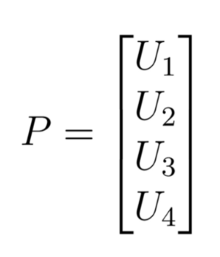
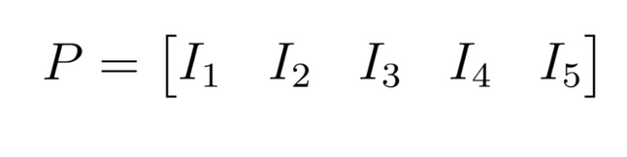
Collaborative filtering (Cosine Similarity)

Slide 9
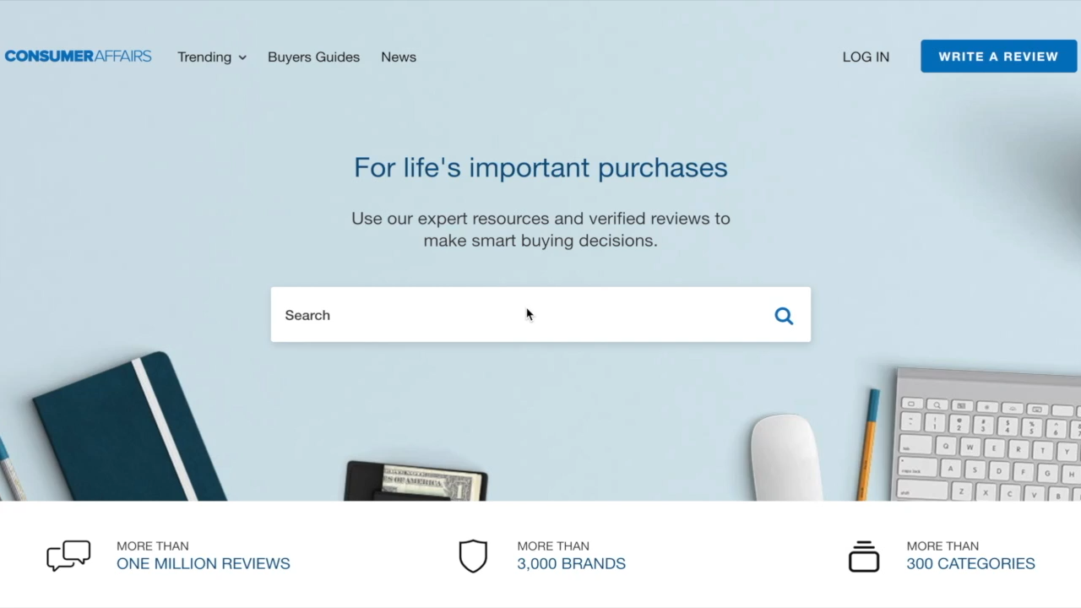
Demo

Slide 10
Deliverables and Outcomes
Getting acquainted with the full stack web development.
Implementing recommendation algorithms.
Getting acquainted with the business side of the project

Slide 11
Project2
Faculty supervisor: William H Beasley
Topic: Insights from Electronic Health Records (EHR)

Slide 12
objective
To predict the estimated cost for the patient visiting the hospital
Data:
The pediatric complex chronic conditions (CCC) classification system, developed in 2000, requires revision to accommodate the International Classification of Disease 10th Revision (ICD-10).

Slide 13
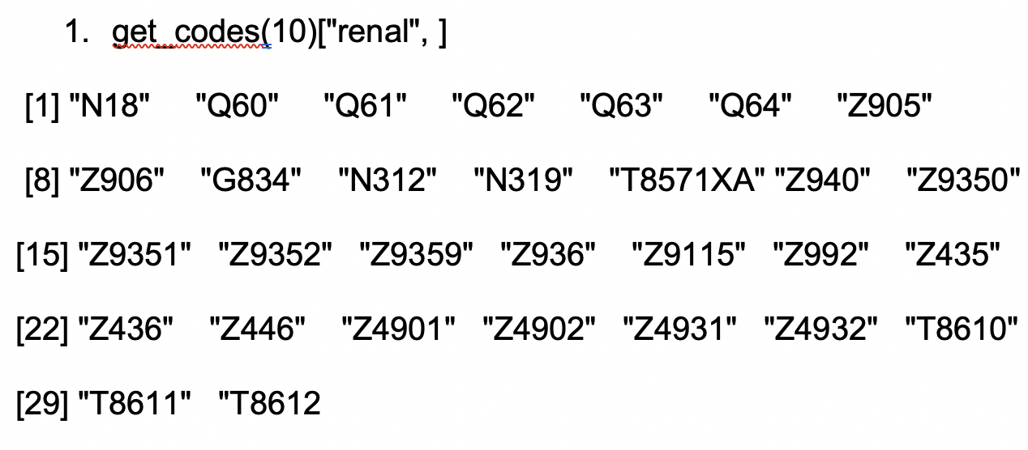
ICD10-codes
Example

Slide 14
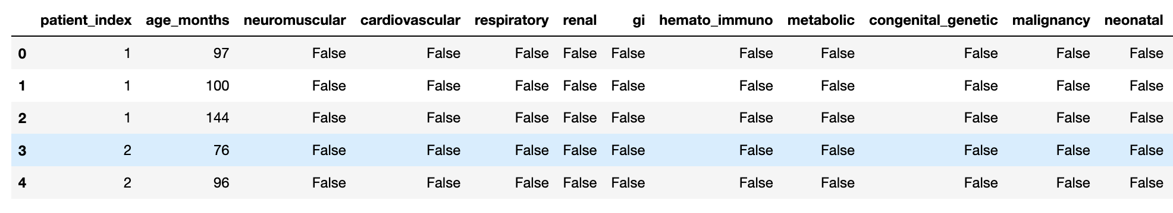
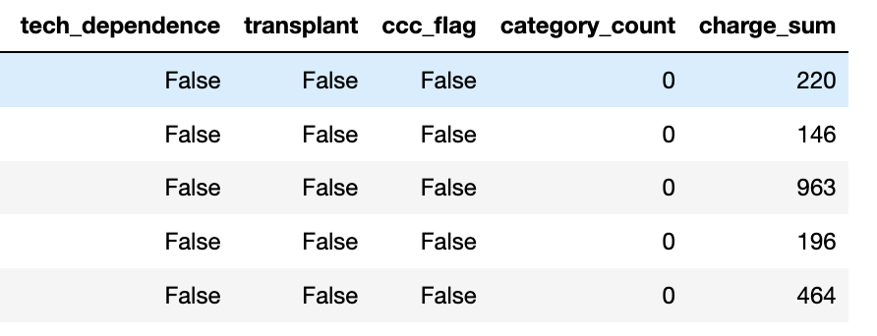
Data Explaination
Two tables:
Table1: pt_month_ccc
Table2: pt_month_invoice
Joining the two columns on Patient Index and age in months.

Slide 15
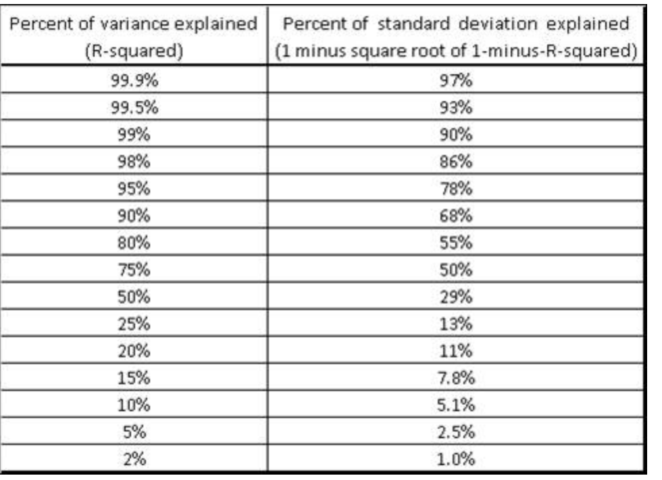
Methodology
R squared Value for a RandomForest regression : .055
Considering the month = 0, Rsquared = .216

Slide 16
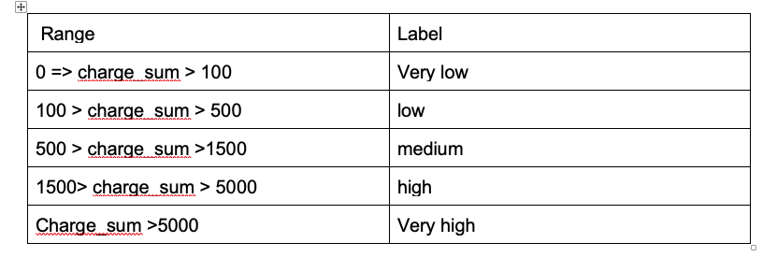
Bins for prices

Slide 17
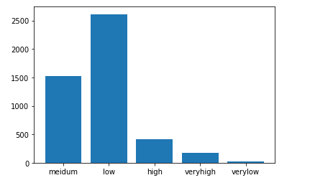
Data Set Imbalanced

Slide 18
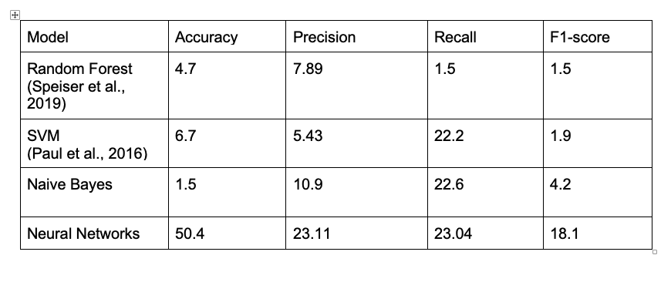
Carry forward ccc indicators and Cumulative ccc indicators

Slide 19
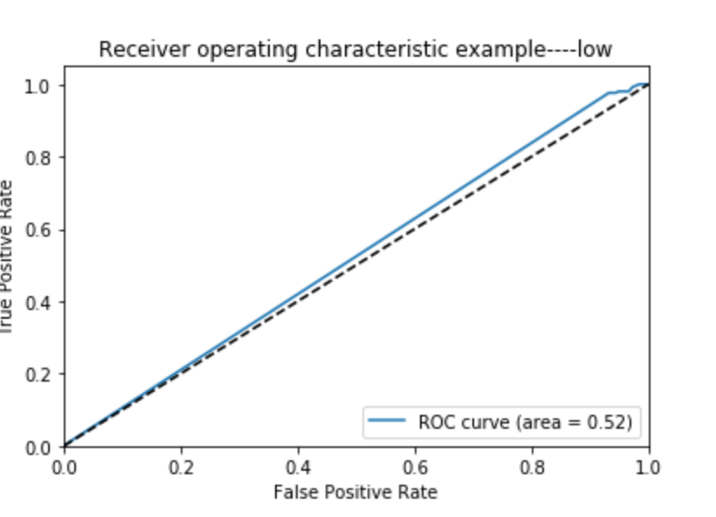
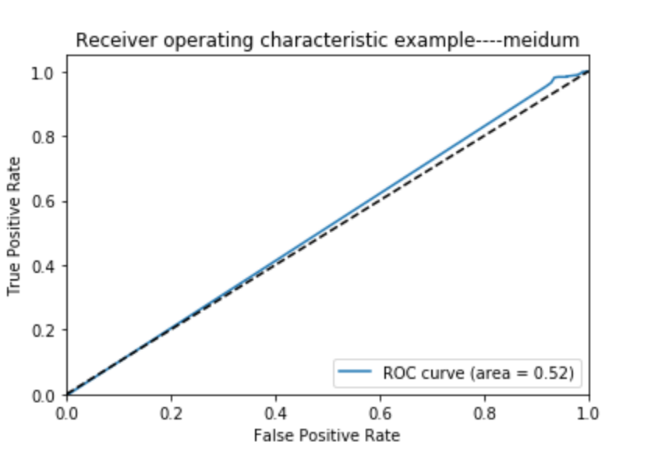
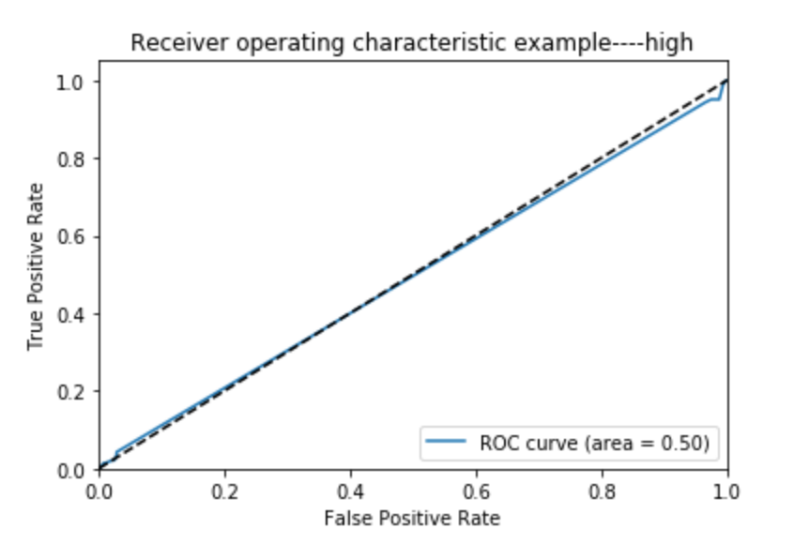
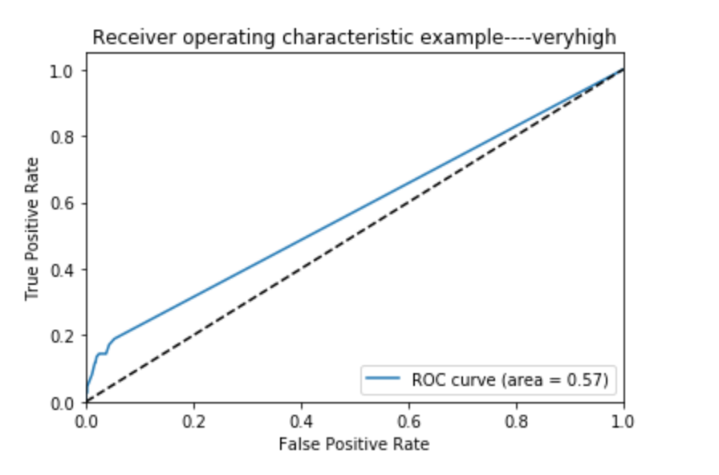
ROC curves -SVM

Slide 20
Inferences
We are unable to predict the cost of treatment for a particular disease.
Eg: 37 3829 0 False False False True False False False False False False False False True 1 1365
247 4863 0 False False False True False False False False False False False False True 1 45380.
Both are examples for renal. For one we can see that charge sum is 1365 and other it is 45380.
Renal is about the kidney failure. There are several stages in renal, cost for treating each stage is independent of one another. The data is unable to recognize the difference between each stage, which is why the results yielded from the dataset are not accurate.

Slide 21
Deliverables and Outcomes
We were able to infer that a detailed analysis of each chronic disease has to be done separately, as the level of severity varies for every patient. Including more features inclined to diagnosis will lead to better results.
Proficient in navigating through Microsoft azure.
Locally storing data in azure data studio using sql server.
Docker to install sql server on MacOS.
Able to perform transformation using SSMS (sql server management studio) and SSIS(sql server integration services).

